Slide 1
Math Vocabulary Operations and Algebraic Thinking M05.B-O variables & expressions/order of operations
Aligning with
Pennsylvania Department of Education
Core Assessment Anchors
and enVision Math Textbook Topic 6 & Topic 15
©2011-2014 Caryn Dingman
www.mrsdingman.com

Slide 2
variable
* a letter or symbol
* letter or symbol stands for an unknown number
Example:
a + 2x + 10
“a” is a variable
“x” is a variable
©2011-2014 Caryn Dingman www.mrsdingman.com
enVision Topic 6
PA Core Assessment Anchor MO5.B-O

Slide 3
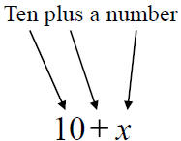
algebraic expression
* a math phrase
* has operational sign(s)
* has variable(s) (letter or symbol)
* has number(s)
expressions have:
NO equal sign
NO answer part
©2011-2014 Caryn Dingman www.mrsdingman.com
enVision Topic 6
PA Core Assessment Anchor MO5.B-O

Slide 4
algebraic expressions
addition clue or signal words
©2011-2014 Caryn Dingman www.mrsdingman.com
enVision Topic 6
PA Core Assessment Anchor MO5.B-O

Slide 5
algebraic expressions
subtraction clue or signal words
©2011-2014 Caryn Dingman www.mrsdingman.com
enVision Topic 6
PA Core Assessment Anchor MO5.B-O

Slide 6
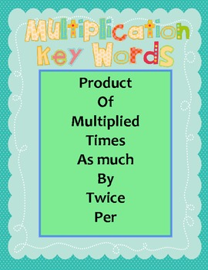
algebraic expressions
multiplication clue or signal words
©2011-2014 Caryn Dingman www.mrsdingman.com
enVision Topic 6
PA Core Assessment Anchor MO5.B-O

Slide 7
algebraic expressions
division clue or signal words
©2011-2014 Caryn Dingman www.mrsdingman.com
enVision Topic 6
PA Core Assessment Anchor MO5.B-O

Slide 8
evaluate the expression
* means to solve a problem
* “simplify the expression” - solve
* solve by replacing the variable with a number
* use the operation given
3 + X = 7
X = 4
©2011-2014 Caryn Dingman www.mrsdingman.com
enVision Topic 6
PA Core Assessment Anchor MO5.B-O

Slide 9
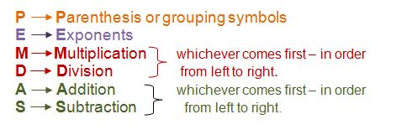
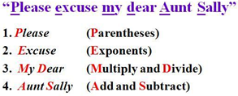
order of operations
* the order in which operations are done to find an answer or solution
(brackets/braces)
in order, left to right
in order, left to right
©2011-2014 Caryn Dingman www.mrsdingman.com
enVision Topic 6
PA Core Assessment Anchor MO5.B-O

Slide 10
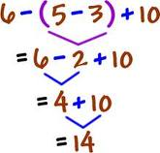
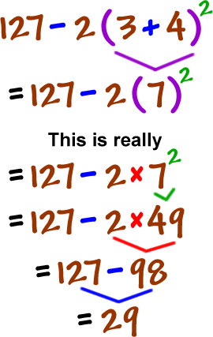
order of operations
examples
©2011-2014 Caryn Dingman www.mrsdingman.com
enVision Topic 6
PA Core Assessment Anchor MO5.B-O

