Slide 1
Math Vocabulary Numbers and Operations M05.A-F fractions & decimals
Aligning with
Pennsylvania Department of Education
Core Assessment Anchors
and enVision Math Textbook Topic 9
©2010-2014 Caryn Dingman
www.mrsdingman.com

Slide 2
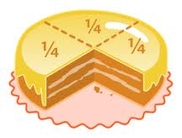
fraction
* describes one or more PARTS of a whole
* whole can be a region
* whole can be a set
* whole can be a segment
examples:
©2010-2014 Caryn Dingman www.mrsdingman.com
enVision Topic 9
PA Core Assessment Anchor MO5.A-F

Slide 3
numerator
* top part of fraction
* shown above the fraction bar
* shows how many equal parts OUT OF total parts
example: 3/5
3 out of 5 parts
©2010-2014 Caryn Dingman www.mrsdingman.com
enVision Topic 9
PA Core Assessment Anchor MO5.A-F

Slide 4
denominator
* bottom part of fraction
* shown below the fraction bar
* represents TOTAL number of equal parts
example: ³/₅
_{3 out of 5 parts}
©2010-2014 Caryn Dingman www.mrsdingman.com
enVision Topic 9
PA Core Assessment Anchor MO5.A-F

Slide 5
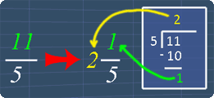
improper fraction
* numerator is larger than denominator
* can be changed to a mixed number
©2010-2014 Caryn Dingman www.mrsdingman.com
enVision Topic 9
PA Core Assessment Anchor MO5.A-F

Slide 6
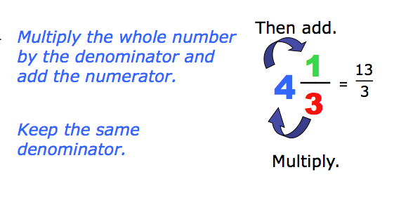
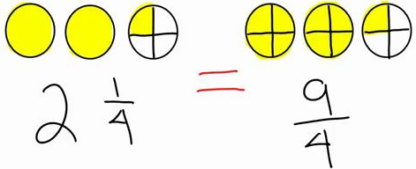
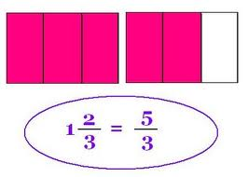
mixed number
* a whole number AND a fraction
* can be changed to an improper fraction
©2010-2014 Caryn Dingman www.mrsdingman.com
enVision Topic 9
PA Core Assessment Anchor MO5.A-F

Slide 7
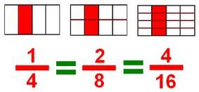
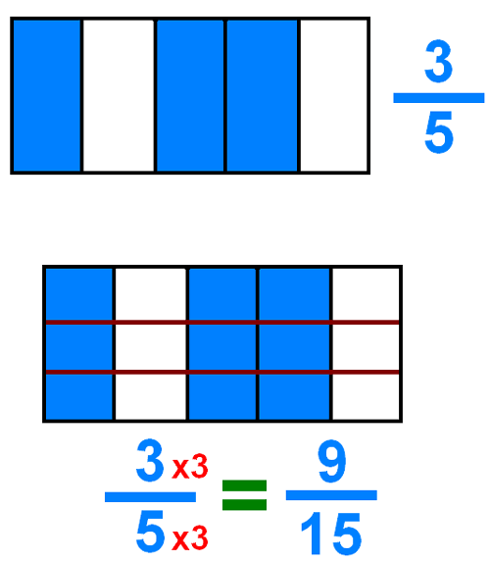
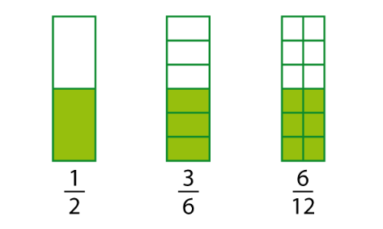
equivalent fractions
* fractions that are equal
©2010-2014 Caryn Dingman www.mrsdingman.com
enVision Topic 9
PA Core Assessment Anchor MO5.A-F

Slide 8
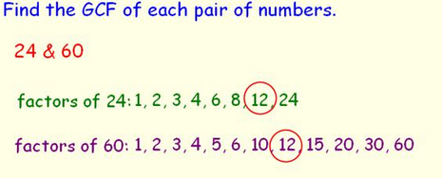
greatest common factor
* also called GCF
©2010-2014 Caryn Dingman www.mrsdingman.com
enVision Topic 9
PA Core Assessment Anchor MO5.A-F

Slide 9
simplest form
* also called lowest terms
* directions may ask to “reduce”
©2010-2014 Caryn Dingman www.mrsdingman.com
enVision Topic 9
PA Core Assessment Anchor MO5.A-F

Slide 10
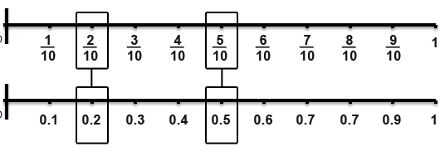
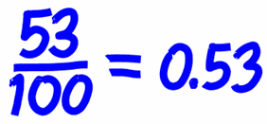
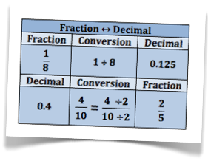
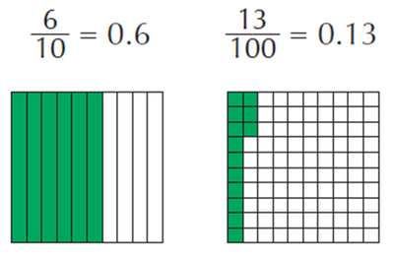
connecting fractions & decimals
©2010-2014 Caryn Dingman www.mrsdingman.com
enVision Topic 9
PA Core Assessment Anchor MO5.A-F

